Slide 1
Cloud Audition Project
Brian R Kabuye

Slide 2
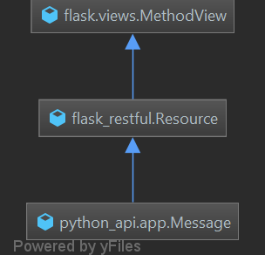
Architecture
Message class in app.py has 3 library dependencies namely:
Flask restful.
Flask.
Re.
Flask gives us the capability to essentially create back-end server and the flexibility to install extensions to support like a database interfacing.
Flask restful is an extension of flask which enables rapid development of REST API(POST, GET, PUT, DELETE).
Re is a library used to manipulate strings.
Messages json acts a data source for the purposes of simulating a database.

Slide 3
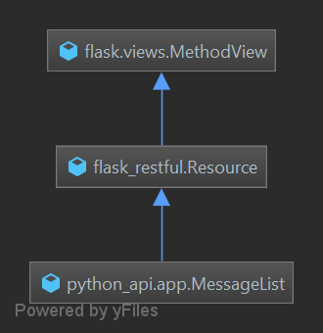
Architecture
Message List is another class just like the message class supporting REST API services and uses the same library dependencies.

Slide 4
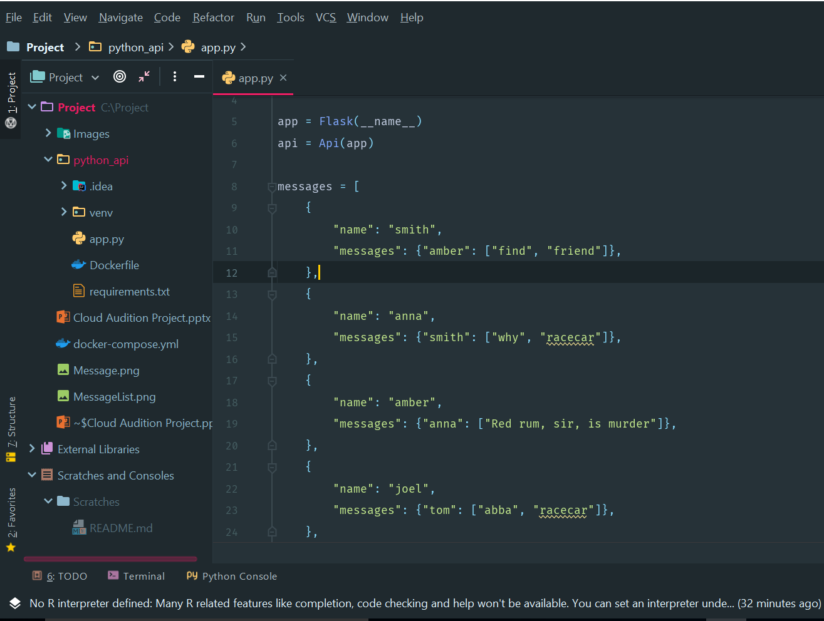
Data Source Json
Messages is a json Database to act as a simulation of a data source.
Messages is a string array that hosts 2 dictionaries. Namely:
Name hosts of the receiver.
Messages.
Messages hosts another dictionary. This dictionary has senders name as the key and string array of messages as the values.

Slide 5
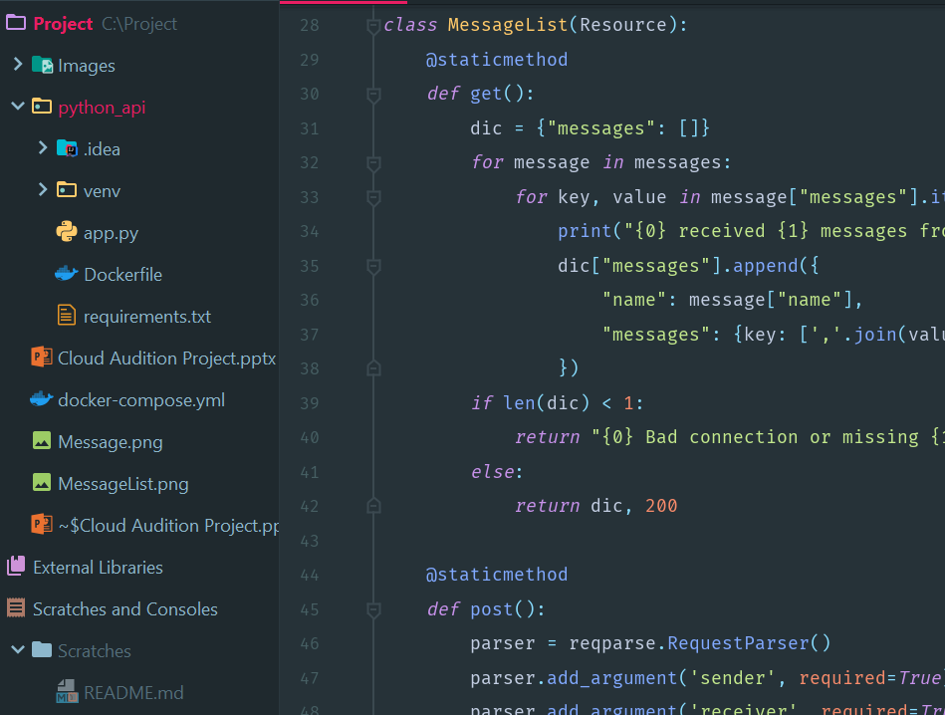
GET RESTFUL API CALL
GET restful API method, handles and responds to get call request via the API, returning a json string display of the messages data source.
If successful, a response with status code 200 is returned, listing all the messages received by each receiver and corresponding sender.
If unsuccessful, a status code 400 is returned, and a String displaying “Bad connection or missing data” as an error response.

Slide 6
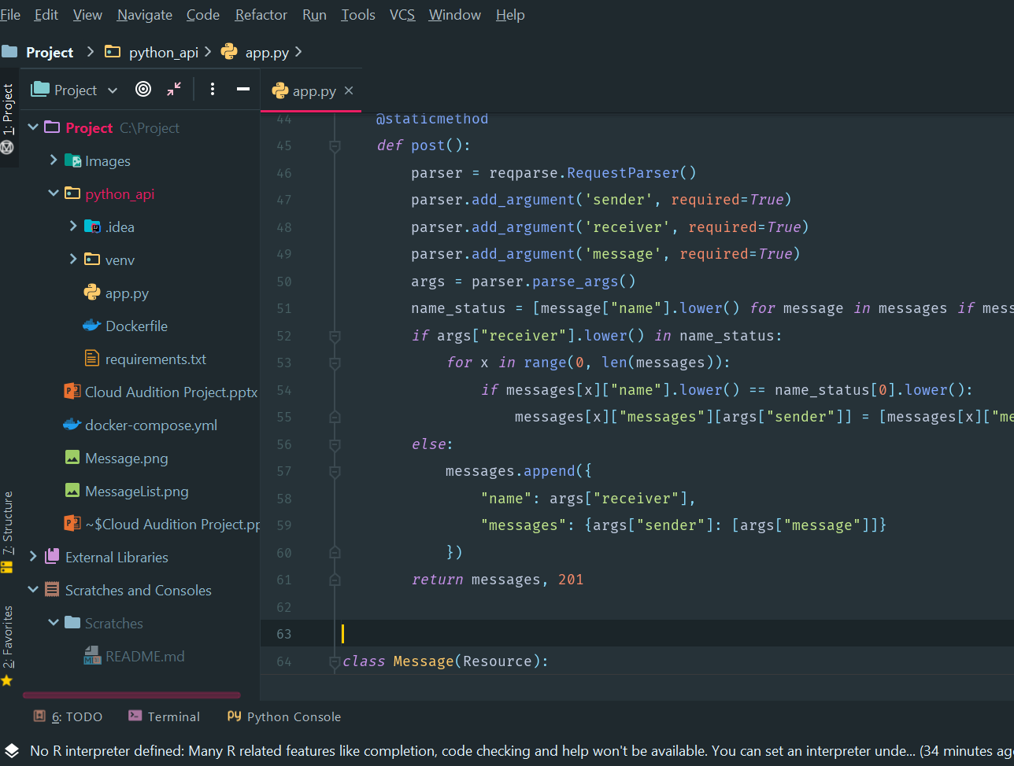
POST RESTFUL API CALL
POST restful API handles and responds to user call request with input, delivered in a json format. Data is parsed and inserted into its corresponding columns in the data source.
Successful insertion returns status code of 201 and updated messages data sources.

Slide 7
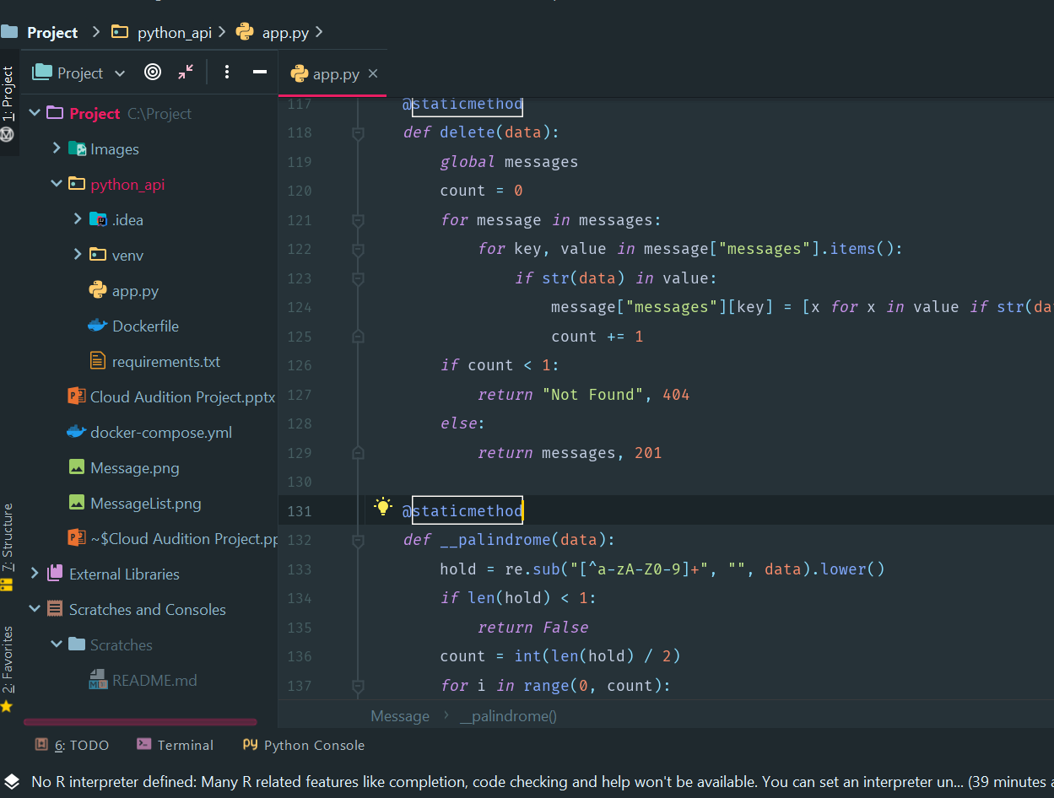
DELETE RESTFUL API
DELETE restful API handles and responds to user call request input to remove or delete particular messages from the data source.
Successful deletion returns response status code 201 and updated data source.
Unsuccessful deletion returns status code 404 & string value “Not Found”.

Slide 8
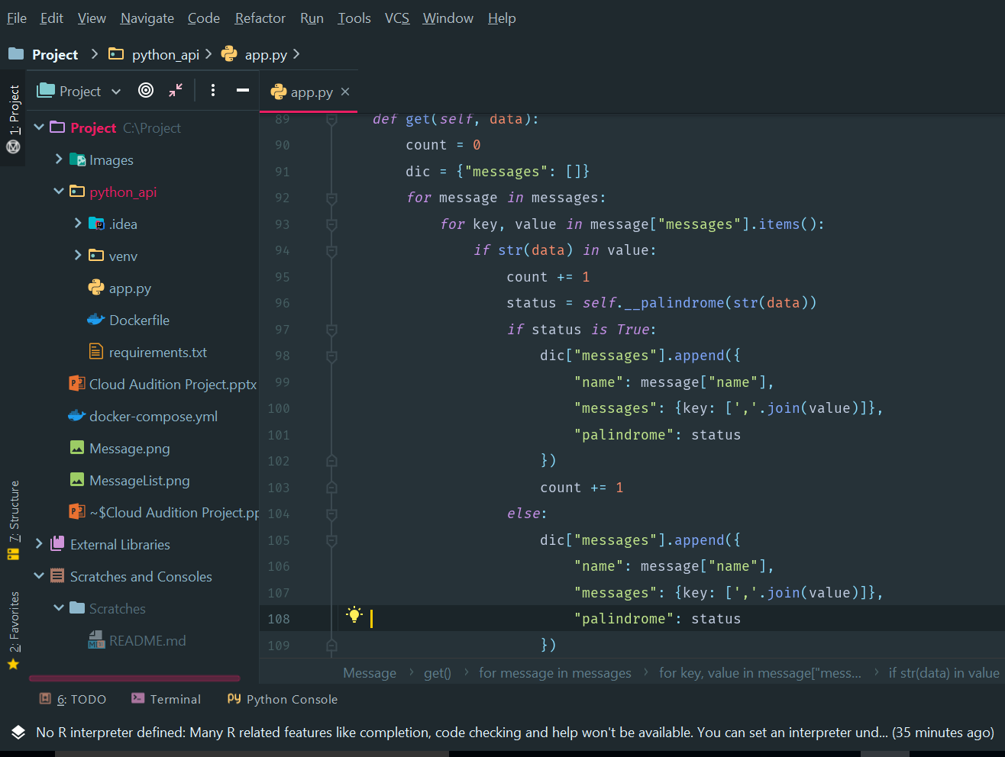
GET RESTFUL API
GET restful API method, handles and responds to get call requests via the API. This particular API retrieves a particular message and verifies if it is a palindrome.
If the specific message exists in the data source, it is validated and assigned a status value of either True or False. This is dependent on the palindrome method.
On success, status code 200 is returned with the specific data sources and a status value.

Slide 9
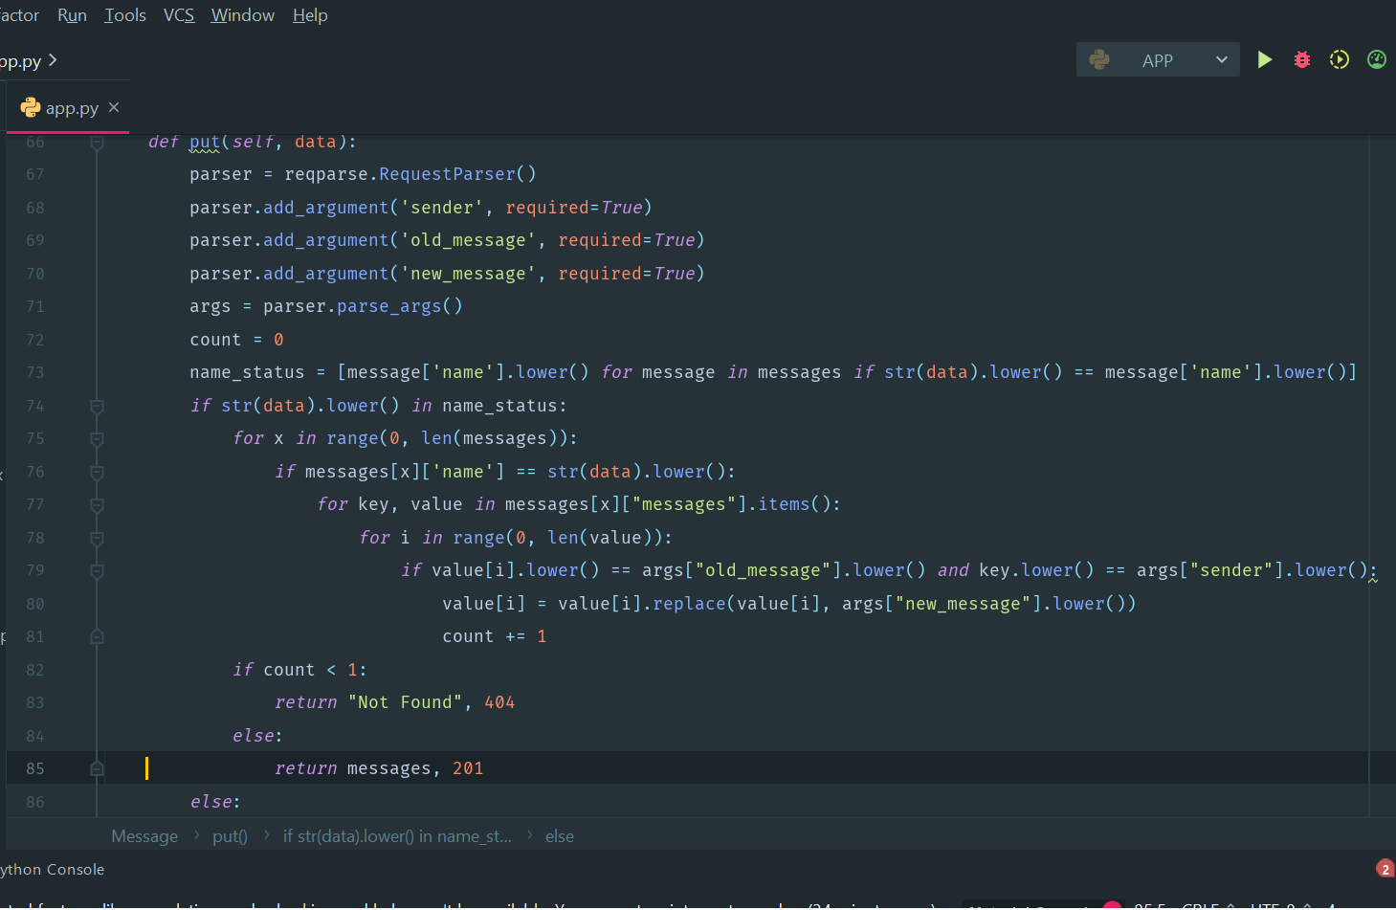
PUT RESTFUL API
PUT restful API handles and responds to user call request. Input wished t be updated is delivered in json format.
It parsed and updated in the corresponding data source column.
Successful update will return status code 201and updated data source.
On Failure, status code 404 is returned and string error message “Not Found”.

Slide 10
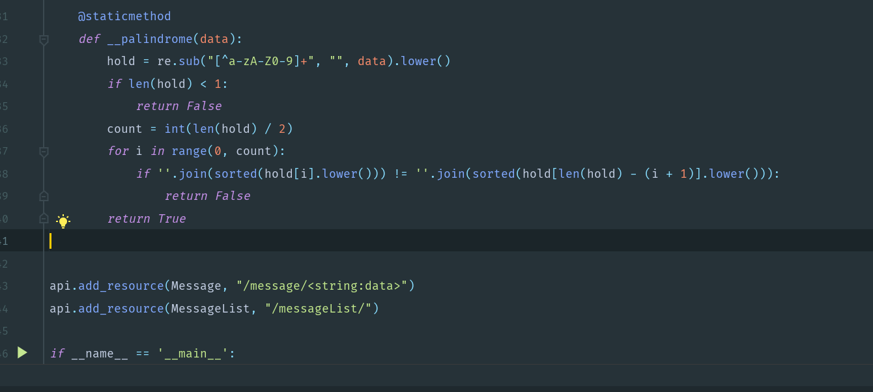
Palindrome method
This is a Boolean method verifying whether a string is a palindrome.
Strings are stripped of any non-numerical and non-alpha characters.
Program loops through the string comparing each first and last letters and next in that sequence for similarity.
If letters are not similar, returns False. If all letters at particular indexes much, it returns True.

Slide 11
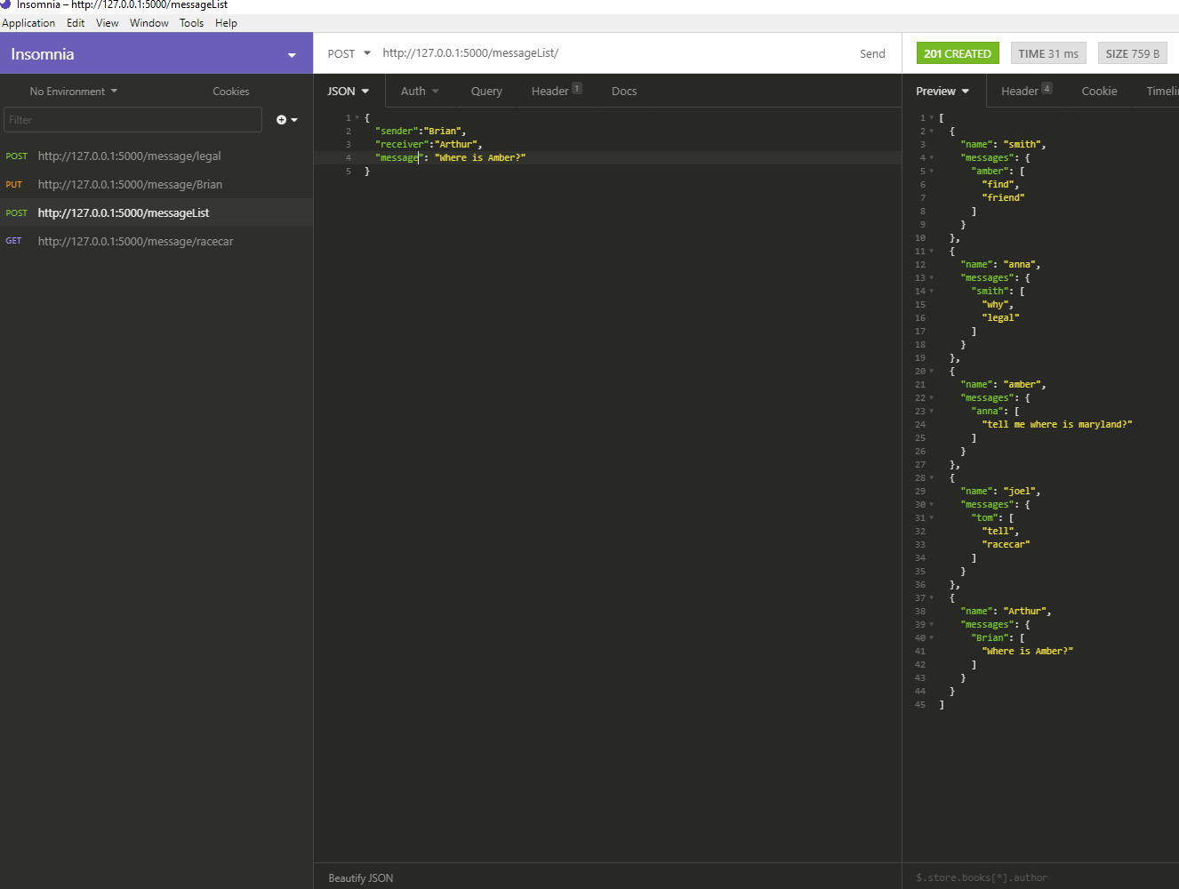
Insomnia REST app
Insomnia rest is a framework I used during the testing of this project.

Slide 12
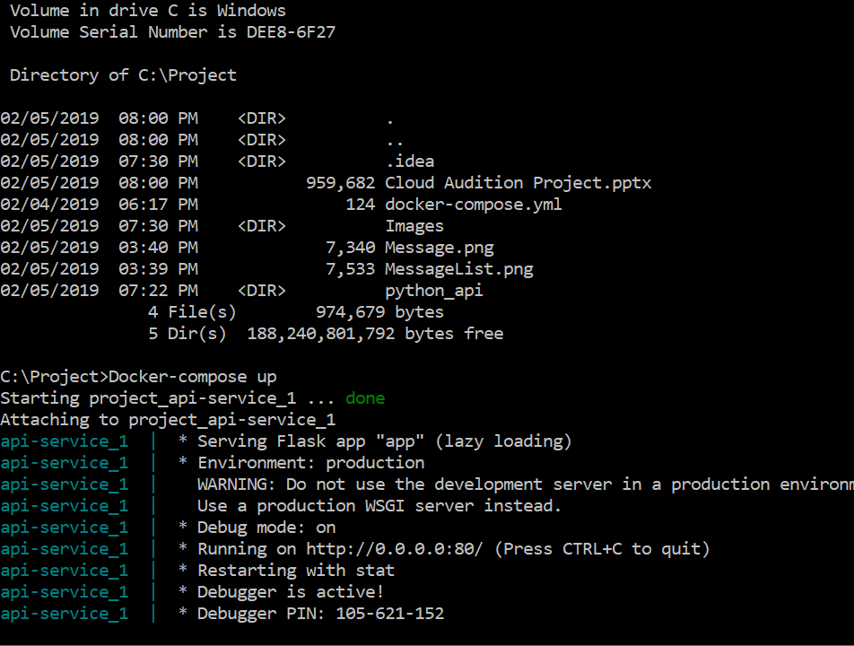
Docker framework
Building and running the code was all carried out using Docker.
http://localhost:5001/messageList/
http://localhost:5001/message/message/

Slide 13
END
Thank you

